Slide 1
On-board Telematics presentation
Vehicle Engineering

Slide 2

Mission
Mission
To propose and develop innovative, scalable and profitable on-board telematics solutions based on common architecture and shared technology
To support the growing soft products business with telematics domain expertise, engaged people and global co-operation for efficient deliveries
Product
People
Organization

Slide 3

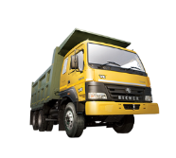
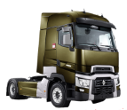
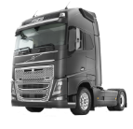
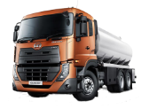
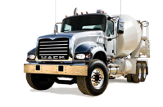
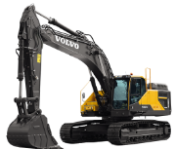
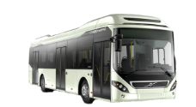
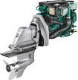
Volvo Group Organization
Group Trucks Sales
Group Trucks Operations
Group Trucks Technology
Construction Equipment
Business Areas
Volvo Financial Services

Slide 4
Group Truck Technology
Valid from January 1, 2015
Group Trucks Technology
Executive Assistant
Torbjörn Holmström
Louise Albert
HR
Agneta Bonna
Controlling & Strategy
Anders Häger
Communication
Sara Jönsson
Legal & Corporate IP
Anna Bjerkelund
Process and IT
Anders Ydergård
Technology Product Project
Christian Cellier
Complete
Vehicle
Christophe Lora
Powertrain
Engineering
Jan Hjelmgren
Vehicle
Engineering
Anders Hellman
Quality &
Customer Satisfaction
Sven Wallström

Slide 5
OBT Organization Structure
On-board Telematics
Mari Hiljemark
Order office & Project portfolio
Erik Malmlöf
Controlling
André Jawahiri
Quality & Process Management
Suresh Varma
Human Resources
Jenny Hedström
Innovation & Partnership Management
Acting GTM Entertainment
Ingmar Bengtsson
Entertainment Functions & Electronics
Mikael Räim
Platform Technology management
Niclas Nygren
VTC & RT Telematics
Katrin Karlsson
NAT Telematics
Johan Hultin
Value Truck Telematics
Ravi Gangappa
UD Telematics
Katsuyoshi Komasaki
System & Product management
Karin Denti
Telematics SW development
Rolf Nilsson
Telematics verification
Anders Brokstorp

Slide 6
On-board Telematics organization - Truck Brands
Mission
Product
People
Organization
On-board Telematics
VTC&RT
Telematics
GOT
NAT
Telematics
GSO
UD
Telematics
Ageo
Value Truck
Telematics
BLR
Brand Solution Units (BSU)
Global Platform & Technology Management
GOT
Global Platform Unit (GPU)

Slide 7
The staff - OBT Telematic SW Development and Verification
GOT
~ 50
BLR
~ 20
Altran
~ 25
-Embedded Software Developers
-Verification Engineers
-Leaders (WP, SW, Verification)
-Architects
-Requirement Managers
-CM (only GOT)

Slide 8
E2E Telematic system overview
Organization
Back Office system – VGT (Volvo Group Telematics) including Wcar (Wireless Car), part of Volvo IT
OnBoard Telematics part of Group Trucks Technology
Onboard ECU – Specified by OBT platform group
SW implemented by OBT SW Development.

Slide 9







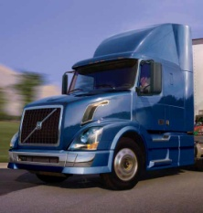
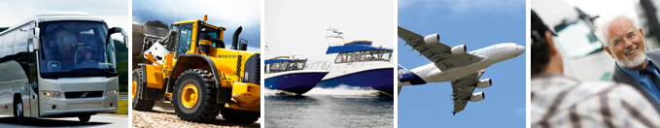
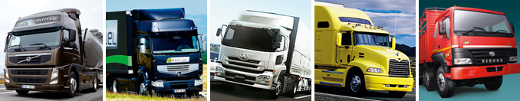
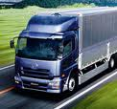
Solution landscape ”to be”*
Mission
Product
People
Organization
Fleet operation, Uptime & Advanced vehicle services
ITS4Mobility
OptiFleet
RoadConnect
Telematics
Brand specific solutions
Brand unique solutions
CAST
Global Telematics Platform
CAST
Global Telematics Platform
V3P
VBC
VCE
*COTAST alignment & timeframe TBD

Slide 10






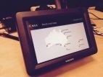
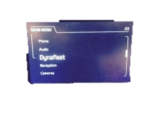
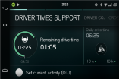
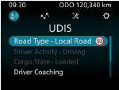




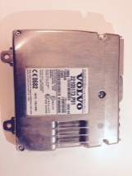
Global On-board Telematics Development Fleet management – Support to the driver
ETC
Wireless toll collection
SW:
HW:
UD TU
Display & applications
Modem, GPS
SW: Fujisoft
HW: Actia
IC - VTNA
Display unit
SW:
HW:
UDIS, Japan
UDIS
VolvoLink
SID++
Display unit
HW: Actia
SID High
Display unit
HW: Continental
TTU
Display & applications
SW: OBT
OS & BSP: OBT
HW: Actia
SEM
Display & applications
SW:
HW:
IC – UD
Display unit
SW:
HW:
Dynafleet, Optifleet
Dynafleet, Optifleet
Dynafleet, Optifleet
Dynafleet, Optifleet
UDIS
TESP
Applications
SW: OBT
OS & BSP: OHB Systems
Navi core: ALK
HW: OHB Systems
TGW 1, 2, 2.1
Applications
Communication (GPRS, 2G/3G, WLAN)
Positioning (GPS)
SW: OBT
OS & BSP: Enea/OBT
HW: Actia
Fleet mgmt - Onboard functions
Navigation
Driver coaching (fuel efficient and safe driving)
Driver time management
Assistance request
SMS, Mail and Fleet messages
Order management
Tachograph data transfer to Back office
Etc.
Dynafleet, Optifleet
Keyboard
HW: Actia
Dynafleet, Optifleet
Dynafleet, Optifleet, Volvo Link, VAS, AVT Fleet, etc.

Slide 11
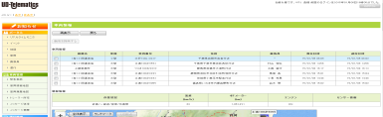
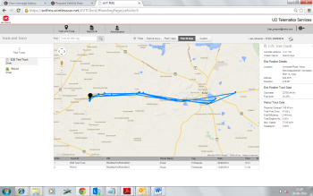
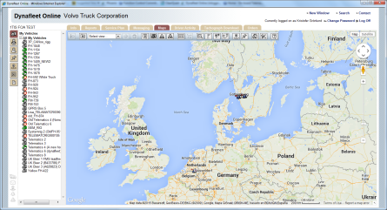
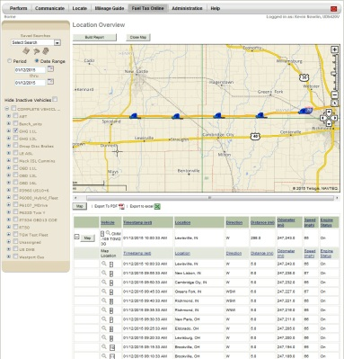
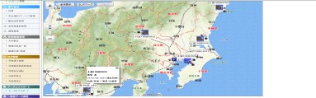

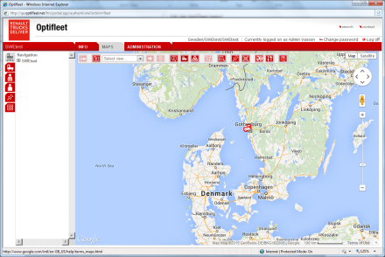
Global On-board Telematics Development Fleet management – Portal solutions
UD Telematics Services/
Eicher Telematics Services
Dynafleet (Volvo trucks)/
Optifleet (Renault trucks)
Volvo Link/
Prevost Liason
Volvo Buses,
Construction equipment etc.
UD Information System
UD Trucks, Japan
UD Trucks, Asia
Eicher Trucks
Volvo trucks, Renault trucks,
FMS trucks (other brands)
Volvo trucks NA,
Mack Trucks
Prevost coaches
Volvo Buses,
Construction equipment etc.
Fleet mgmt - portal functions
Tracking vehicles on map
Vehicle event alerts
Reports and statistics (vehicle & driver)
Order management
Driver times management
Messaging
Service planning
Etc.
TGW 2 (also 1 and 2.1)
Applications
Communication (GPRS, 3G, WLAN)
Positioning (GPS)
SW: OBT
OS & BSP: Enea/OBT
HW: Actia
UD TU
Display & applications
Modem, GPS
SW: Fujisoft
HW: Actia

Slide 12
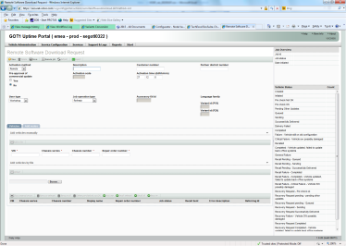
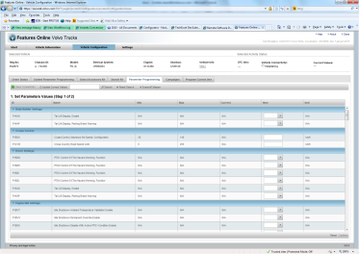
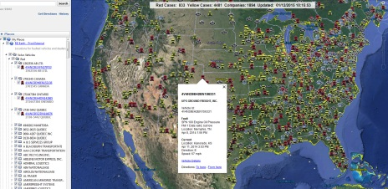

Global On-board Telematics Development Uptime services
Uptime portal
Features online
Volvo Remote diagnostics
/Guarddog connect
Volvo action service
Call-center
ERA-GLONASS
Call-center
Volvo trucks, UD Trucks, Japan
Volvo trucks, EMEA
Volvo trucks, Mack trucks, North america
Volvo trucks
ERA Union, Russia
TGW 2 (also 1 and 2.1)
Applications
Communication (GPRS, 3G, WLAN)
Positioning (GPS)
SW: OBT
OS & BSP: Enea/OBT
HW: Actia
ERA-GLONASS
Applications
Communication (3G)
Positioning (Glonass)
Uptime Functions
Remote ECU SW upgrade
Remote vehicle SW parameter setting
Remote diagnosis of fault codes
Road assistance (VAS Call)

Slide 13
Project Team
OBT PM
Project Verification Leader
System Leader
SW Project Architect
Function owner
Technical Leader
HW
Role descriptions
Notes:
Actually, all roles have been changed. But these two roles have major changes. They will break down the scope according to the new process.

Slide 14
SW Factory – Team Set Up
Product Owner
Backlog Platform
Backlog Business
PF1 GOT
PF2 GOT
Business 1 GOT
Business 2 BLR
Business 3 BLR
SW Product Architect
SW Verification Architect
Business 4 Altran
MRRT Backlog
E2E Backlog GOT
E2E Backlog GSO
E2E Backlog AGEO
E2E Backlog BLR
MRRT GOT
MRRT / E2E Altran
MRRT / E2E Altran
E2E GOT
E2E GSO
E2E BLR
E2E AGEO
CM
PF3 Altran
Business App Altran
Scrum
KanBan

Slide 15
V-cycle
Complete Vehicle level
Truck feature spec
system Implementation and delivery
System (or sub-network) level
Kanban - Agile way of working
E2EF spec
ECU(HW+SW) E2E system delivery
ECU system level
ECU-system spec
ECU(HW+SW) delivery- ECU
Component level
SW factory-Agile way of working
LDC spec
LDC Implementation and delivery
SWC level
SWC Implementation and delivery

Slide 16
Start of sprints
Sprints and scrum teams will start each week:
Which will make the organisation more flexible. Take care of PRs quickly
This requires a new CM plan for branches
Projects have to plan the CRs and BLIs to match the deliveries to the Projects and the WP plan
w04
Code Freeze
w01
Sprint team 1
Sprint team 1
Sprint team 1
Sprint team 2
Sprint team 2
Sprint team 2
Sprint team 3
Sprint team 3
Sprint team 4
Sprint team 4

Slide 17
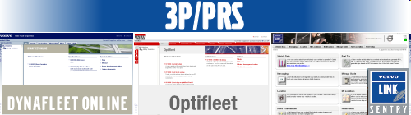
Volvo Group Telematic Products
Develop on-board software for the fleet management systems:
Dynafleet, Volvo Trucks Europe
Optifleet, Renault Trucks Europe
Volvo Link, Volvo Trucks North America
AVT, Volvo Trucks Asia
UDIS, Volvo Trucks Japan

Slide 18
Development tools
Rhapsody
C++,
ClearCase and GIT
Jira
Caliber
SE-tool
Lauterbach, Lint, Klocwork (2016)
CANoe
Jenkins
Visual Studio
Eclipse (Android dev)
Robot

Slide 19
Onboard SW Architecture – GTAG4
GTAG4 – Global Telematic Architecture generation 4

